Slide 1

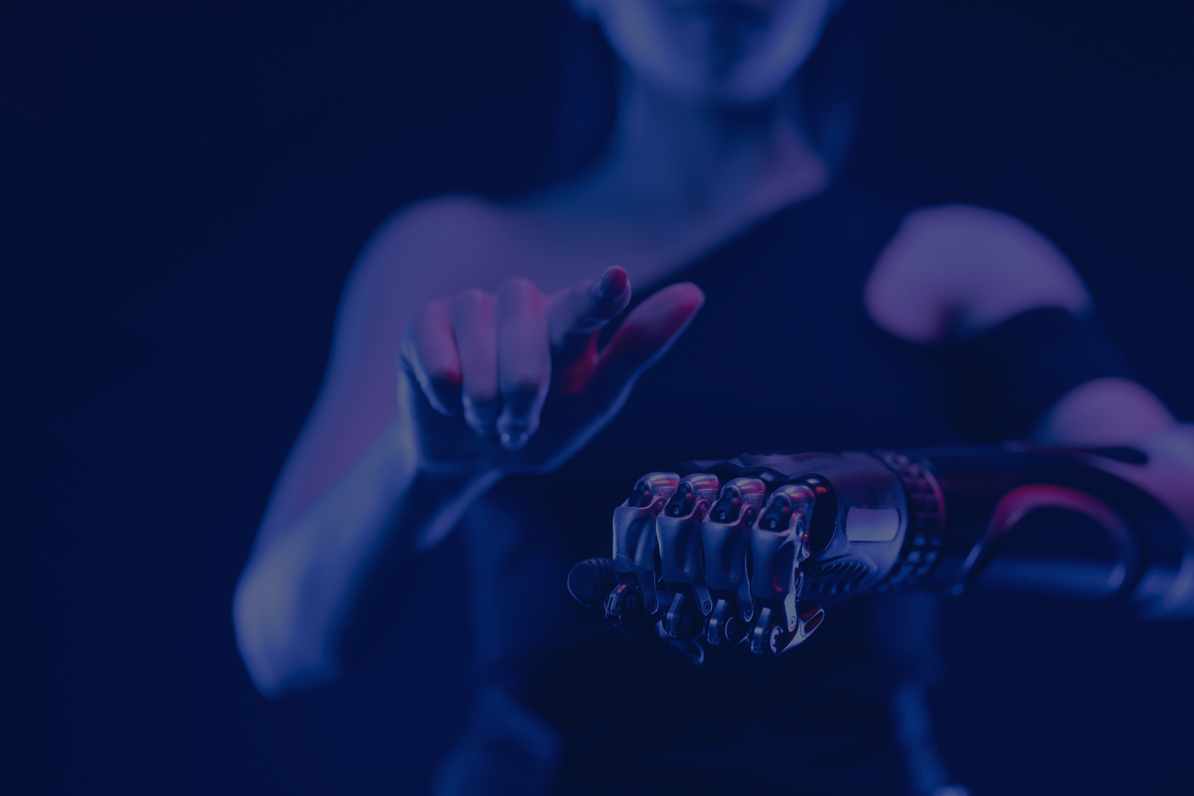

AI unlimited
Harnessing
Generative AI for Manufacturing Innovation:
Applications and Opportunities
M11209202 黃雅婄 Huang Ya Pei
Notes:
https://ieeexplore-ieee-org.ntust.idm.oclc.org/document/10463265

Slide 2



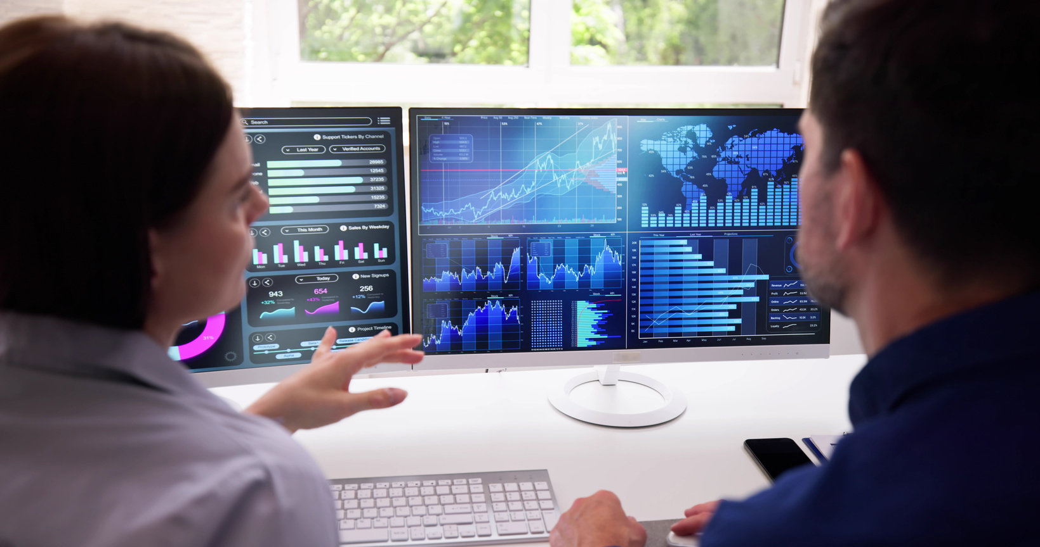
Harnessing Generative AI for Manufacturing Innovation : Applications and Opportunities
02
AI unlimited
Syllabus
Introduction
Discussion
Literature Review
Conclusion
Harnessing Generative AI for Manufacturing Innovation :
Applications and Opportunities
Notes:
This is our syllabus, we will talk about introduction
literature review
discussion
and conclusion.

Slide 3



1
AI unlimited
Introduction
M11209202 Huang Ya Pei

Slide 4


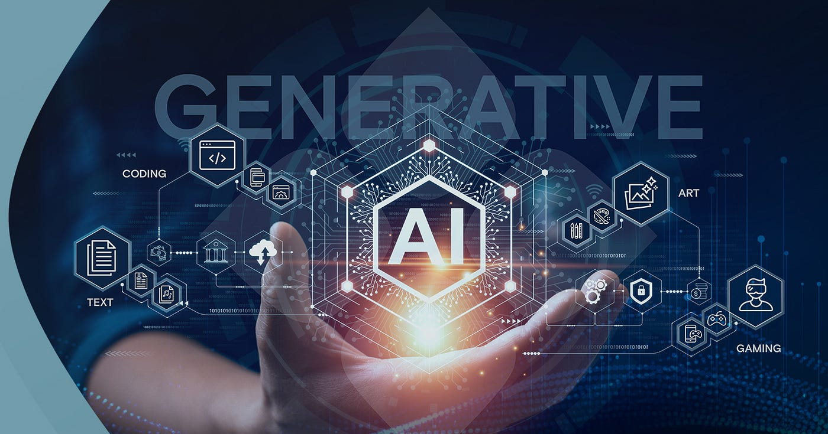
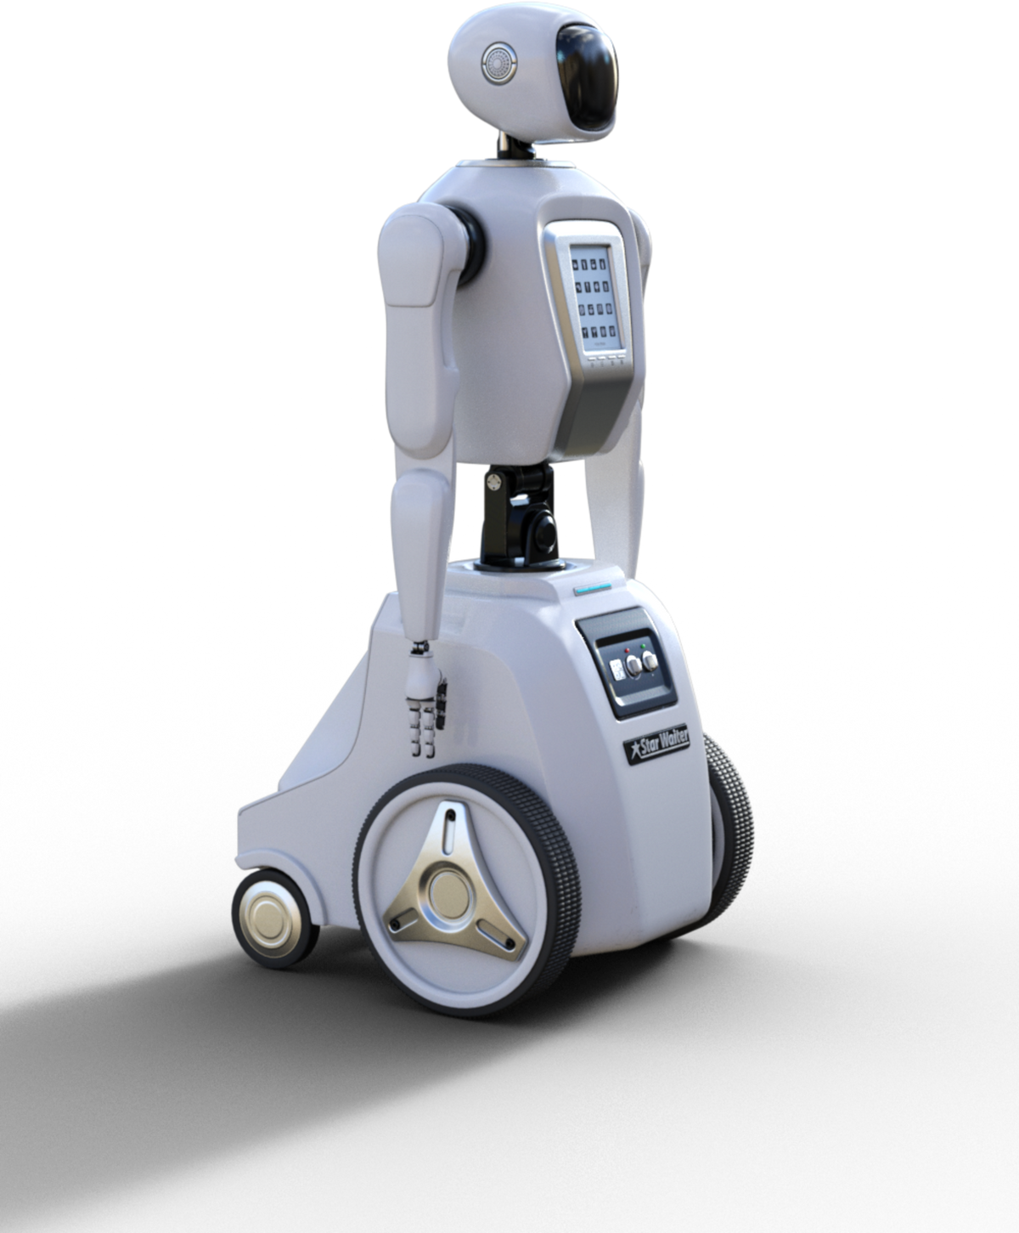
AI unlimited
Generative AI
Generative Artificial Intelligence / GenAI
revolutionizing the manufacturing industry
class of artificial intelligence
a breakthrough in computational intelligence
03
Introduction
Notes:
First of all ,
Generative Artificial Intelligence, or GenAI, is revolutionizing the manufacturing industry. GenAI is a class of artificial intelligence that can create new content, such as text, images, or sounds, by learning patterns from existing data. It's a breakthrough in computational intelligence, consisting of algorithms that generate new data patterns identical to accurate data.
生成式人工智能，或稱GenAI，如何革新製造業。GenAI是一種人工智能技術，能夠通過學習現有數據模式生成新的內容，如文本、圖像或聲音。這是一個計算智能的突破，包含能生成與真實數據模式相同的新數據的算法

Slide 5
AI unlimited
1. Evolution of Manufacturing
Key part of modern economies
Changed significantly over centuries
Driven by various industrial revolutions
Generative AI
08
Introduction
Notes:
The manufacturing sector is a key part of modern economies and has changed a lot over the centuries due to various industrial revolutions. Each revolution brought new technologies, societal changes, and economic advancements.
製造業是現代經濟的關鍵組成部分，幾個世紀以來，由於各種工業革命，製造業已經發生了很大變化。每一次革命都帶來了新技術、社會變革和經濟進步。

Slide 6
AI unlimited
2. The Fourth Industrial Revolution
AI
Big Data
Internet of Things (IoT)
Generative AI
08
Introduction
Notes:
Right now, the industry is in the middle of the Fourth Industrial Revolution. This involves adopting digital technologies like AI, big data, and the Internet of Things (IoT).
每一次工業革命都帶來了新技術、社會變革和經濟進步。現在，製造業正處於第四次工業革命之中，這包括採用人工智能、大數據和物聯網等數字技術。

Slide 7
AI unlimited
3. Drivers of Change
Cost-efficiency
Environmental sustainability
Climate concerns
Generative AI
08
Introduction
Notes:
Many top manufacturers are leading the way in digital transformation, but the entire industry is still catching up. This change is driven by the need to cut costs, be more environmentally sustainable, and address climate concerns.
許多頂級製造商在數位轉型方面處於領先地位，但整個行業仍在追趕中。這項變化是由削減成本、提高環境永續性和解決氣候問題的需求所推動的。

Slide 8
AI unlimited
4. Impact on the Industry
Changes in labor dynamics
New production methods
Transformation of global supply chains
Generative AI
08
Introduction
Notes:
As a result, we are seeing significant shifts in how labor is managed, how products are made, and how global supply chains operate.
因此，我們看到勞動力管理、生產方式和全球供應鏈運作方面的重大轉變。

Slide 9
2
AI unlimited
Literature Review
M11209202 Huang Ya Pei

Slide 10
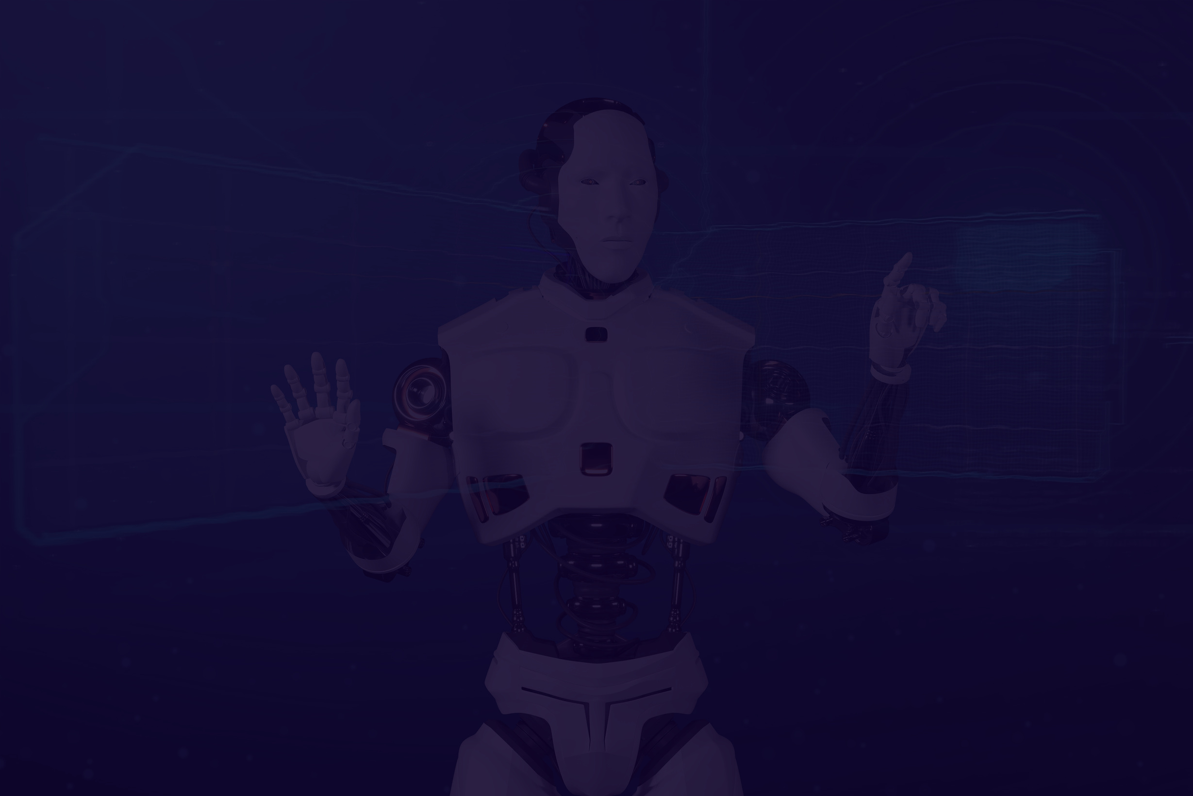
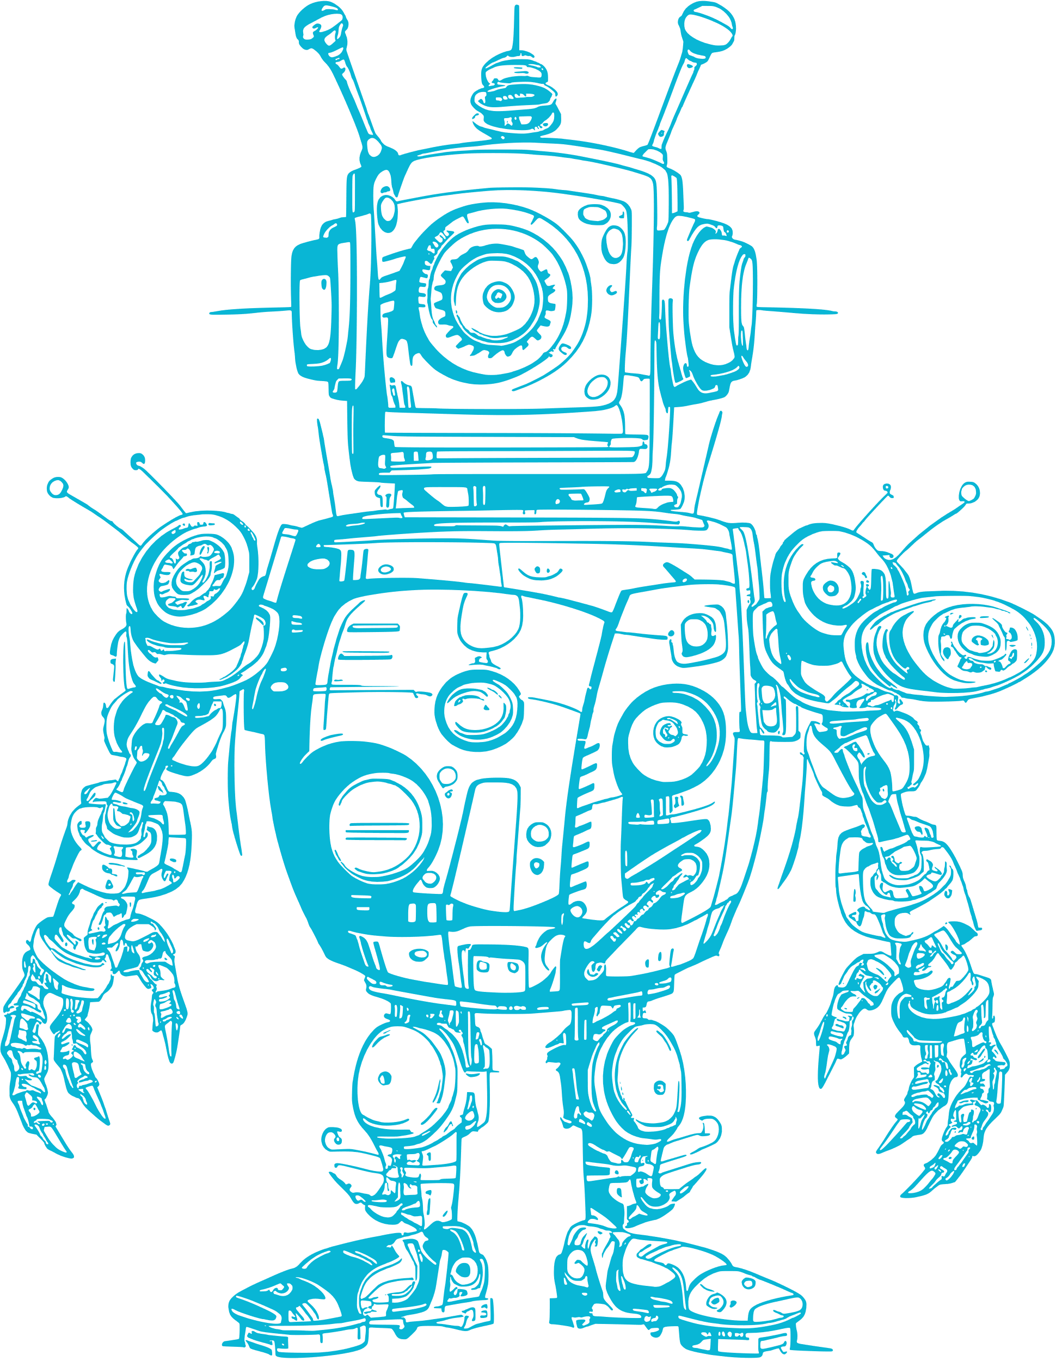

02
AI unlimited
Project Overview
Our Artificial Intelligence project aims to develop advanced algorithms and machine learning models to solve complex problems in various domains. By leveraging AI technologies, we seek to enhance efficiency, accuracy, and decision-making processes.
Literature Review
Literature Review

Slide 11
3
AI unlimited
Discussion
M11209202 Huang Ya Pei

Slide 12
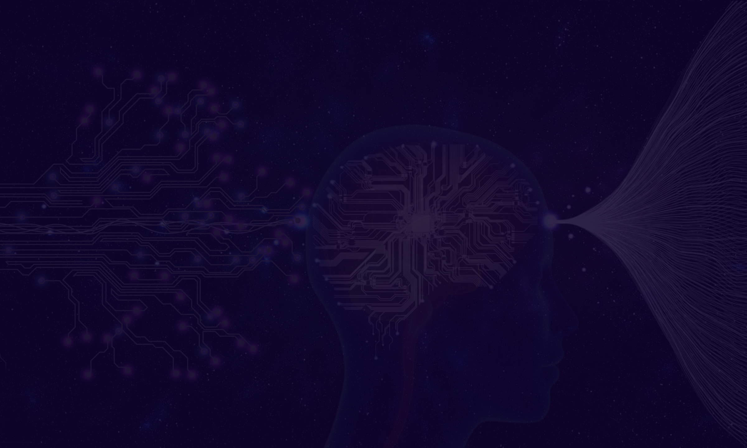

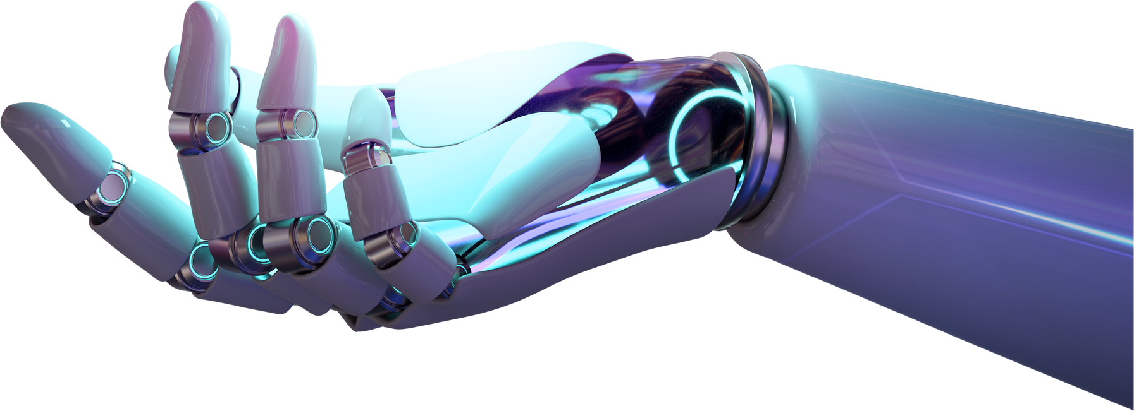
AI unlimited
Problem Statement
We identify key challenges or opportunities within a specific domain that can benefit from AI solutions. This includes tasks such as predictive analytics, natural language processing, computer vision, and robotics.
03
Discussion

Slide 13
4
AI unlimited
Conclusion
M11209202 Huang Ya Pei

Slide 14

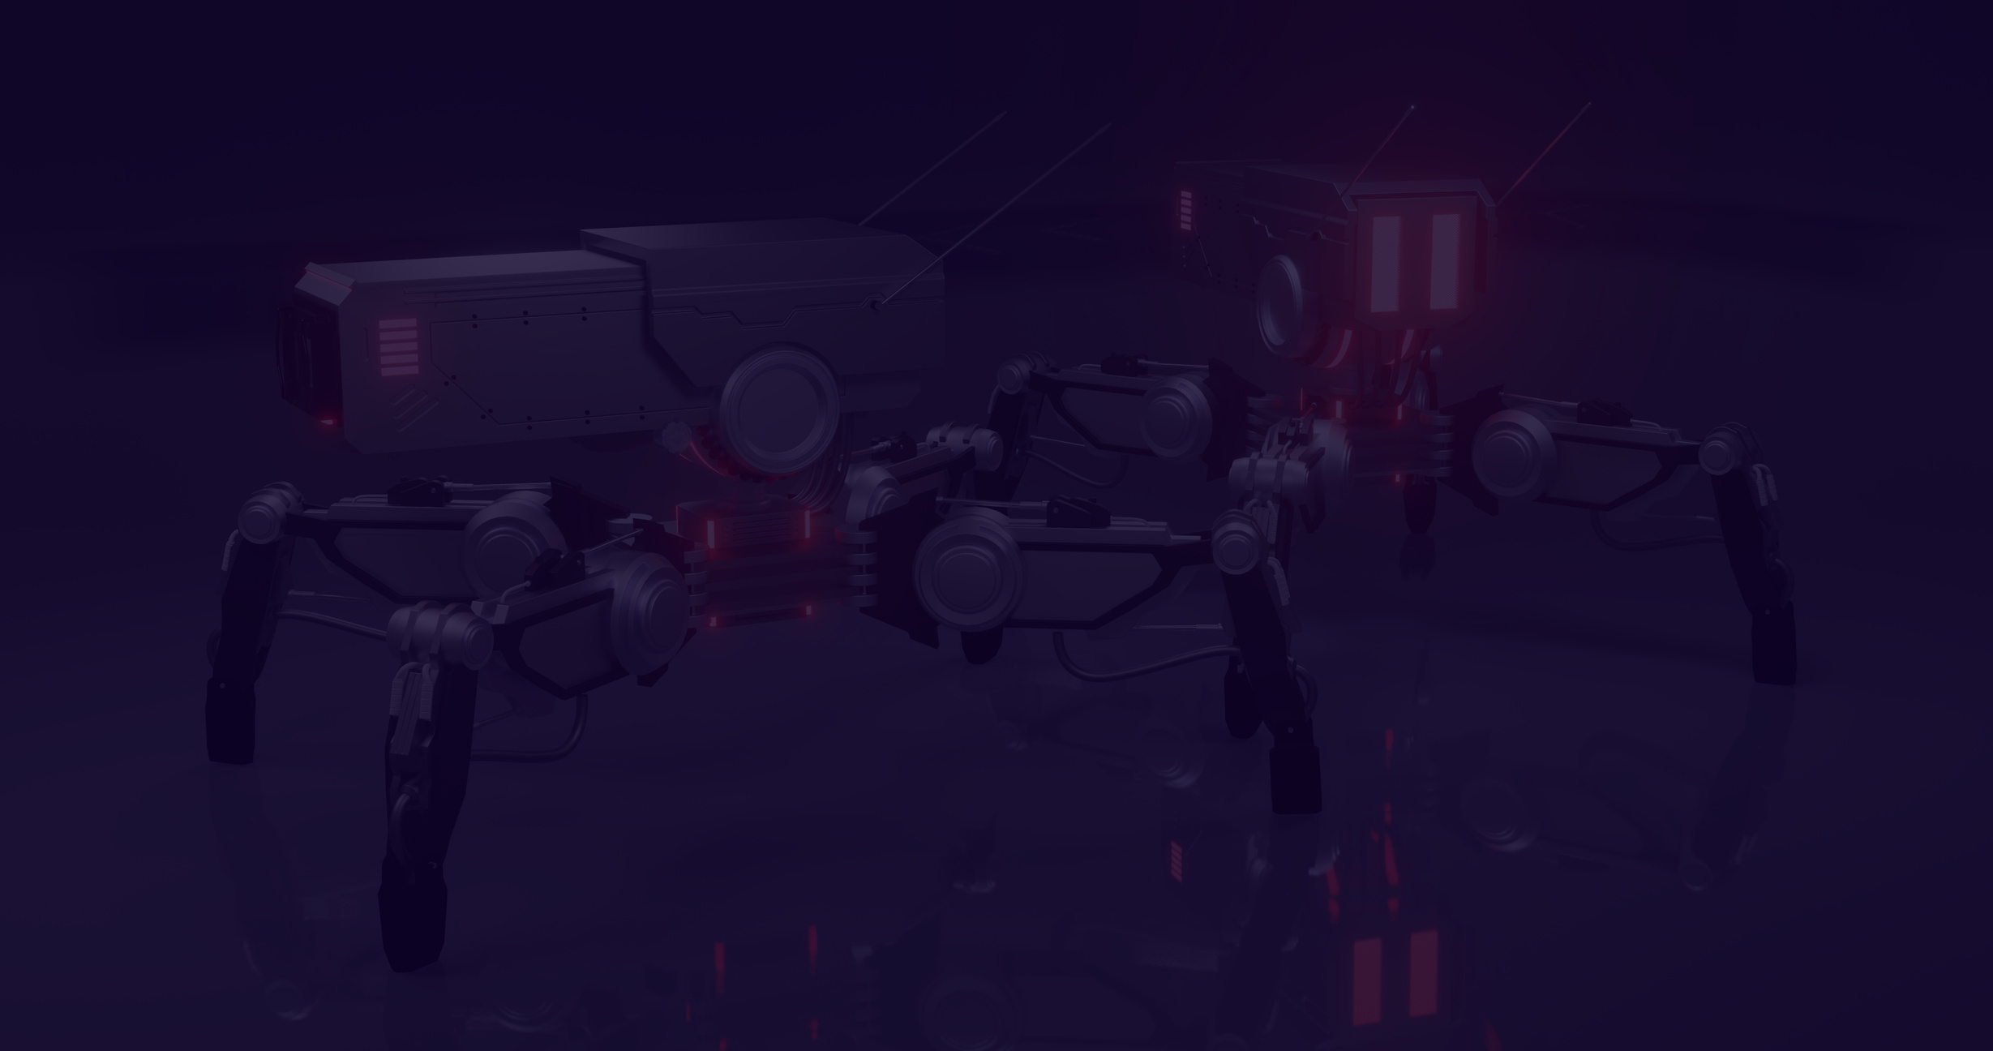

06
AI unlimited
Model
Development
We design and implement machine learning and deep learning models tailored to the specific requirements of the project. This involves experimenting with different architectures, hyperparameters, and optimization techniques.
Conclussion

Slide 15


AI unlimited
Thank You!
for listening
M11209202
M11209202 Huang Ya Pei

Slide 16

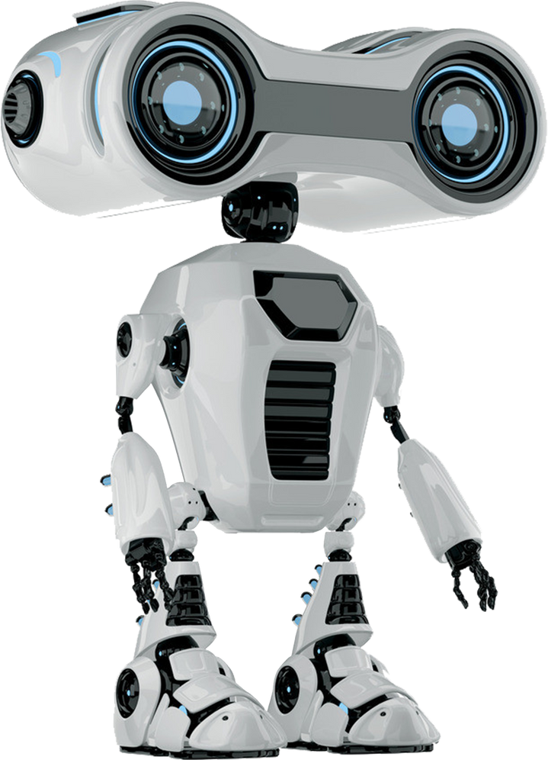
05
AI unlimited
Data Collection and Preprocessing
We gather relevant datasets from various sources and clean, normalize, and preprocess the data to ensure its quality and consistency. This step is crucial for training accurate and reliable AI models.

Slide 17



07
AI unlimited
Evaluation Metrics
We define appropriate metrics to assess the performance of our AI models, such as accuracy, precision, recall, F1 score, and area under the curve (AUC). These metrics help us quantify the effectiveness of our solutions.
www.reallygreatsite.com

Slide 18
04
AI unlimited
Methodology
Data Collection
Preprocessing
Model Selection
Gather relevant data from diverse sources.
Clean, normalize, and engineer data.
Choose and train ML/DL algorithms for peak performance.
www.reallygreatsite.com

Slide 19
07
AI unlimited
Evaluation Metrics
We define appropriate metrics to assess the performance of our AI models, such as accuracy, precision, recall, F1 score, and area under the curve (AUC). These metrics help us quantify the effectiveness of our solutions.
www.reallygreatsite.com

Slide 20

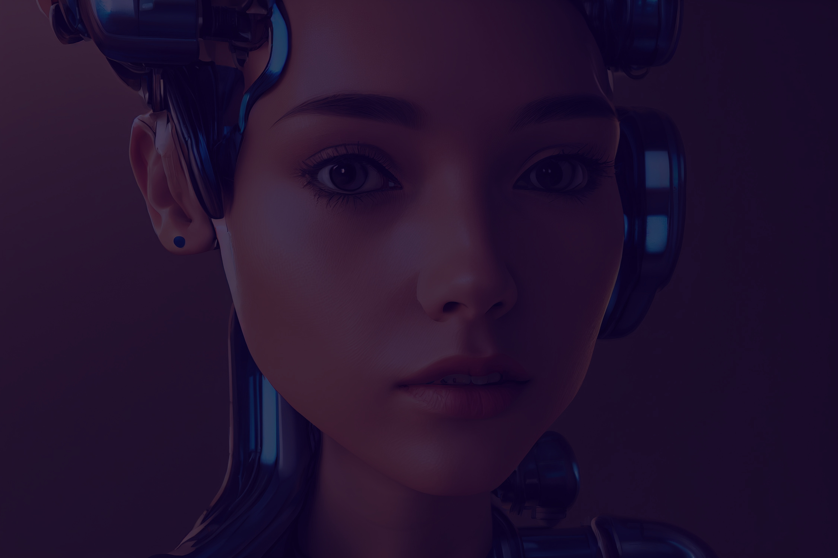
AI unlimited
Future Directions
We outline future directions for our AI project, including scalability, generalization, integration with existing systems, and exploring new applications and domains. Continuous research and development are essential for staying at the forefront of AI innovation.
www.reallygreatsite.com

